Slide 1
ML Deployment using AWS Elastic Beanstalk
Pritha Ghosh
Vibhanshu

Slide 2
Workflow
Build the Machine Learning Model - Message Classification as Spam/Legitimate
Create a Flask Application
Create a Spam Detector API
Deploy on AWS Elastic Beanstalk

Slide 3
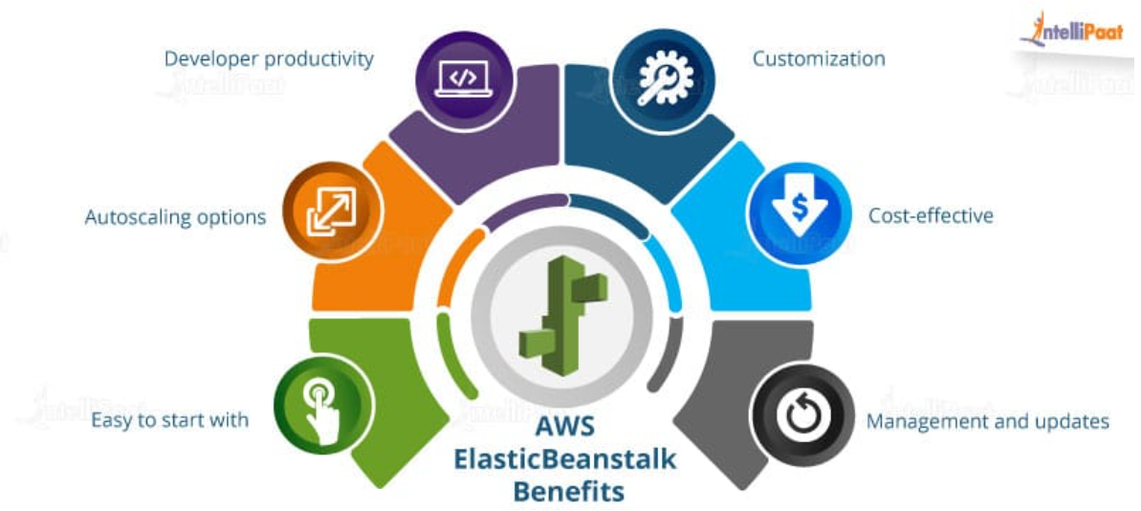
AWS Elastic Beanstalk- PaaS Model

Slide 4
AWS Elastic Beanstalk Advantages
Developer Productivity: Developers don’t need to think much about uploading their application online, they only have to concentrate on keeping their application more secure and user friendly.
Autoscaling and Server Management: Auto Scaling helps you maintain application availability and allows you to automatically add or remove instances through trigger configuration. Infact, flexibility of server management is what differentiate PaaS from serverless models making PaaS models more flexible.
Customization: AWS Elastic Beanstalk allows you to select the configuration of your AWS services that you have used with your application. For example, consider Amazon EC2, you can change the instance type which is optimal for your application. Also, if you want to take control of some services manually, you can change the settings according to it.
Cost Effective: There is no additional charge for AWS Elastic Beanstalk. You pay for AWS resources (e.g. EC2 instances or S3 buckets) you create to store and run your application. You only pay for what you use, as you use it; there are no minimum fees and no upfront commitments. This is the upper hand that AWS has over Azure.
Management and updates: You don’t need to worry about updating your application according to the change in the platform. The software patches, platform updates, and infrastructure management are taken care of by the AWS professionals.

Slide 5
AWS Elastic Beanstalk Advantages
6. Monitoring: You can leverage monitoring dashboard to view key performance metrics such as latency, CPU utilization, and response codes. You can also set up CloudWatch alarms to get notified when metrics exceed your chosen thresholds.
7. Application Health: Elastic Beanstalk collects 40+ key metrics and attributes to determine the health of your application.

Slide 6
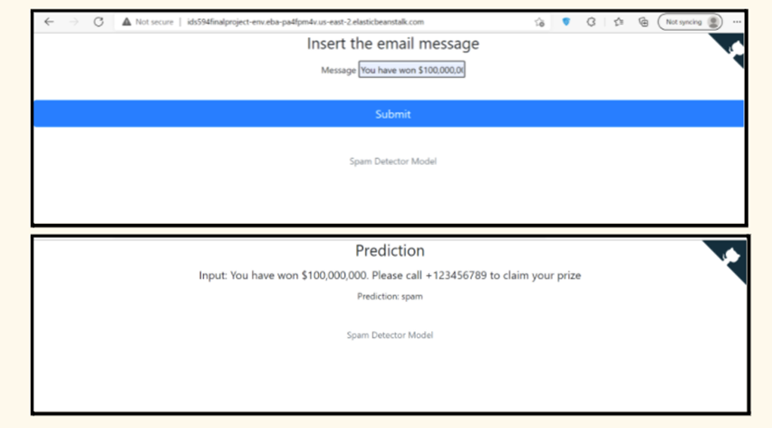
SPAM DETECTOR MODEL IN PYTHON

Slide 7
SPAM DETECTOR MODEL IN PYTHON
We use a dataset on Kaggle to build our Spam Detector Model: SMS Spam Collection Dataset | Kaggle.
The SMS Spam Collection is a set of SMS tagged messages that have been collected for SMS Spam research.
It contains one set of SMS messages in English of 5,574 messages, tagged according to ham (legitimate) or spam.
The model takes an input from the user and classifies it as spam or ham.

Slide 8
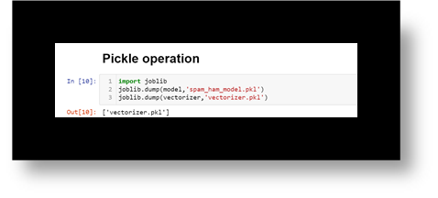
SPAM DETECTOR MODEL IN PYTHON- PICKLE FILE
The pickle module implements binary protocols for serializing and de-serializing a Python object structure.
Pickling is a process in which a Python object hierarchy is converted into a byte stream and unpickling is the
inverse operation where a byte steam is converted back into an object hierarchy.
If we want to use the Spam detector ML model in the API,
we have to pickle the model as well as the vectorizer function.

Slide 9
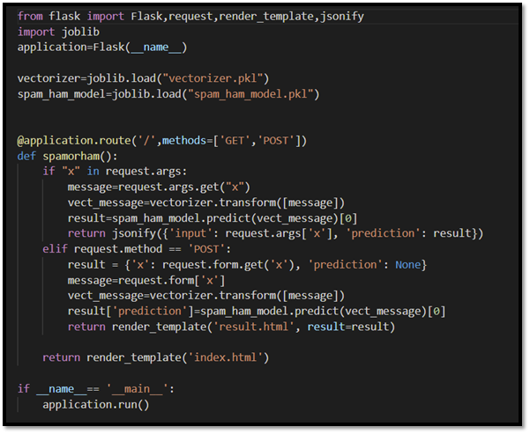
Create a Flask Application & API

Slide 10
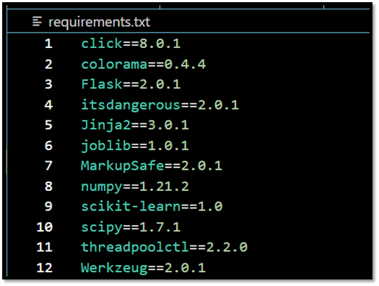
Dependencies - Requirements.txt

Slide 11
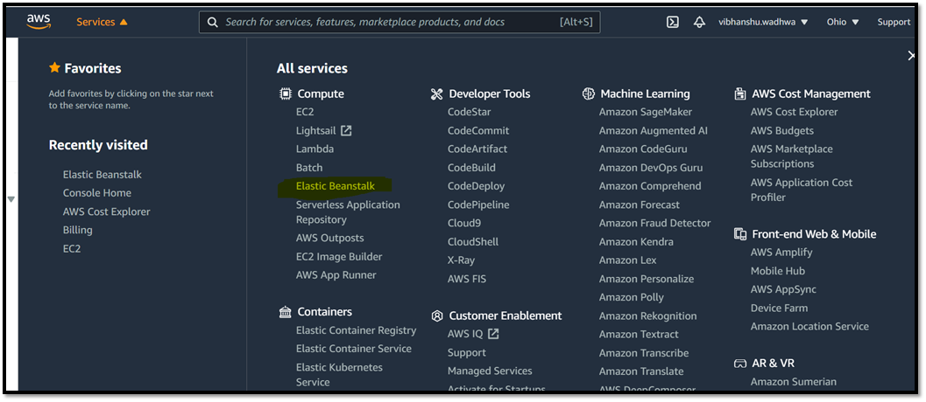
AWS- Elastic Beanstalk

Slide 12
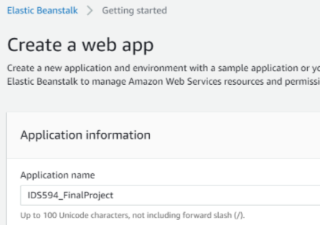
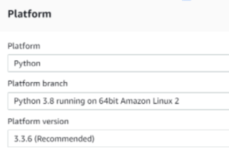
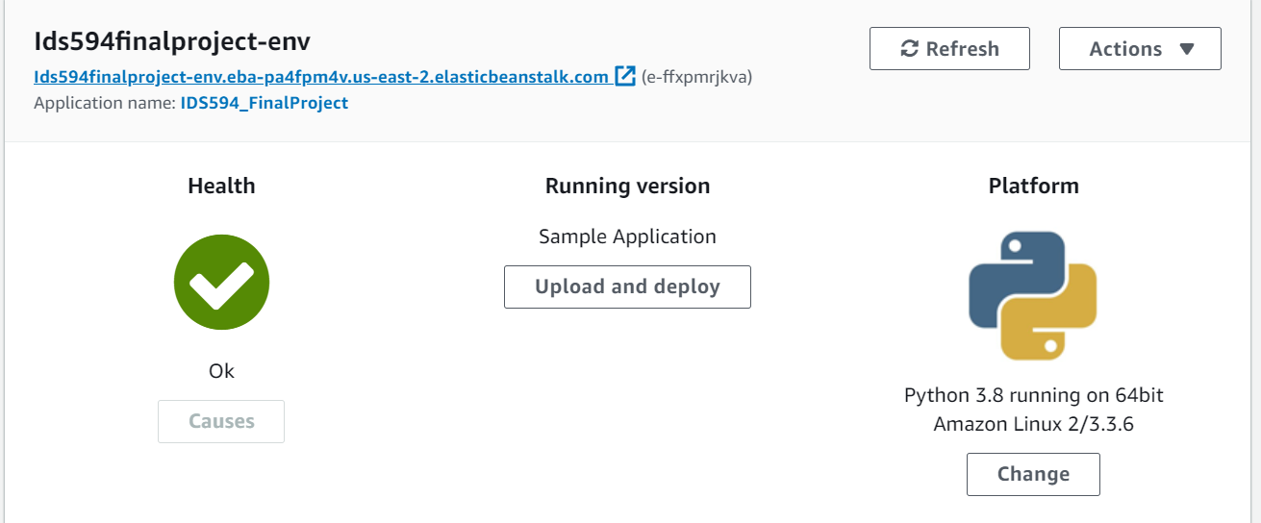
AWS- Elastic Beanstalk

